Slide 1
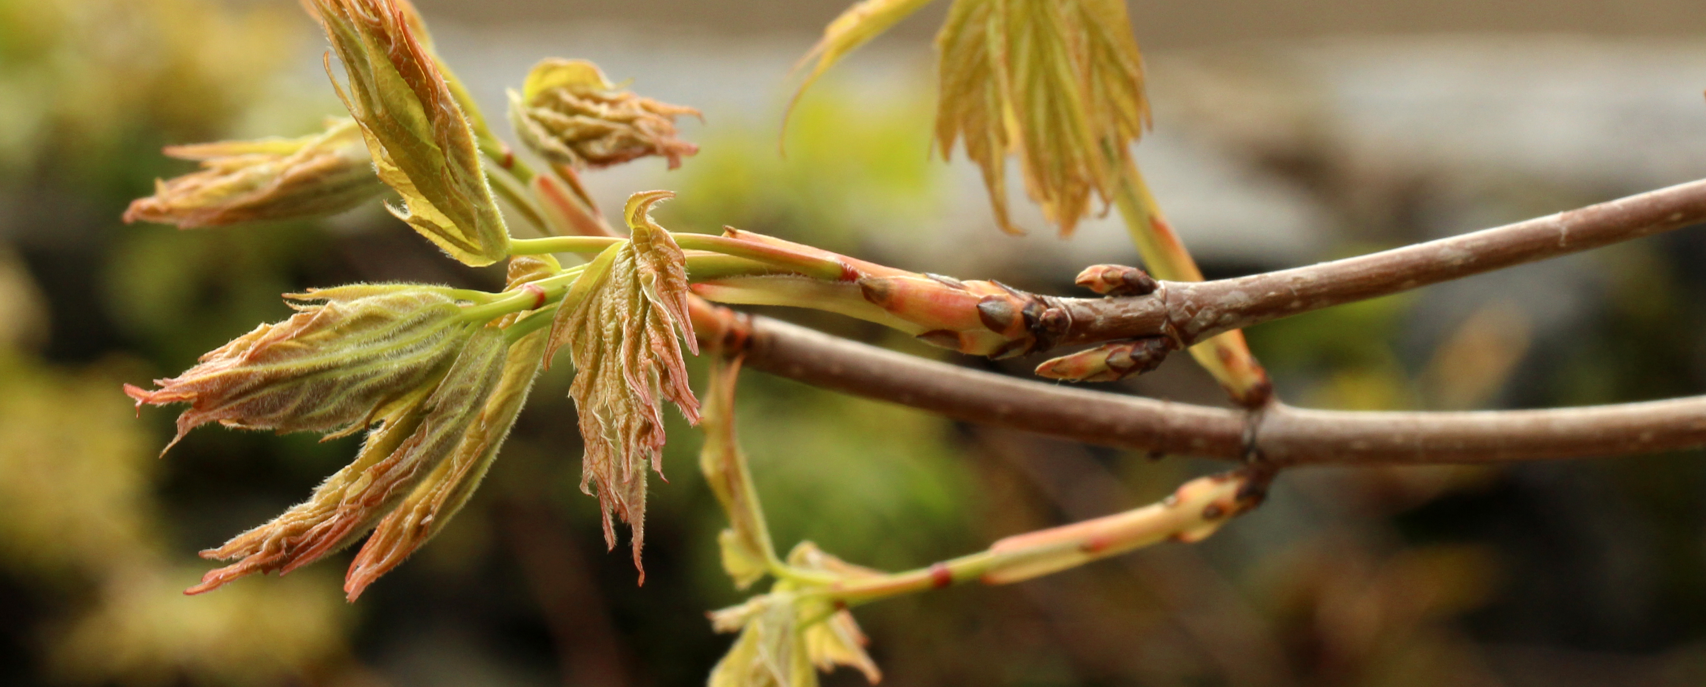
Photo Cred: Suz Mrozak
Understanding plant phenology in a warming world
Examining microclimatic effects

Slide 2
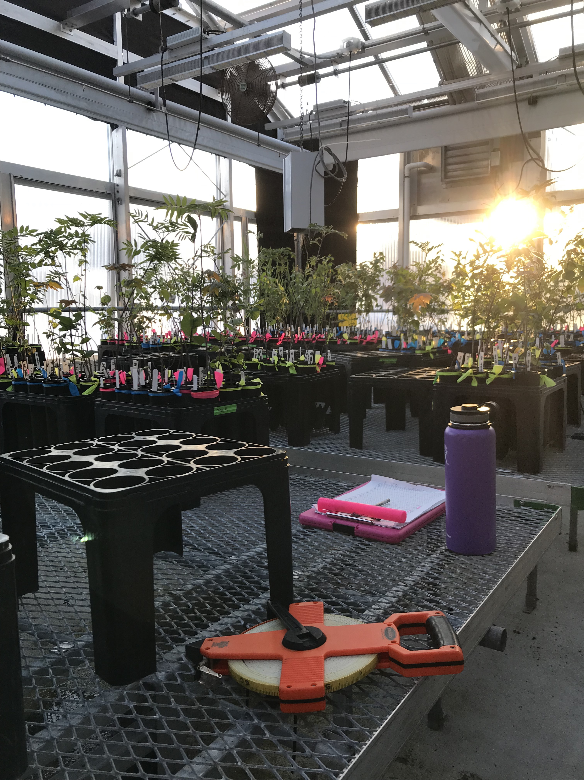
DEFINITIONS:
1) Phenology: timing of life-history events
2) False Springs: late spring freezing events after budburst has occurred
3) Microclimates: climate of a very small area, especially if it differs from the larger, surrounding area

Slide 3
Budburst: start of spring
Over-Winter Chilling
Spring Warming
Daylength

Slide 4
Growing Degree Days (GDDs)
Definition: accumulation of spring warming temperatures
If temperature is greater than 0℃, then you add up the temperatures
Temp (℃) – 0 ℃ = X
E.g., Temperature is 5 ℃ for Day 1, 7 ℃ for Day 2 and -2 ℃ for Day 3
Day 1: 5 – 0 = 5
Day 2: 7 – 0 = 7
Day 3: -2 - 0 = 0 (doesn’t count)
So by Day 3, 12 GDDs (5+7) have been accumulated.

Slide 5
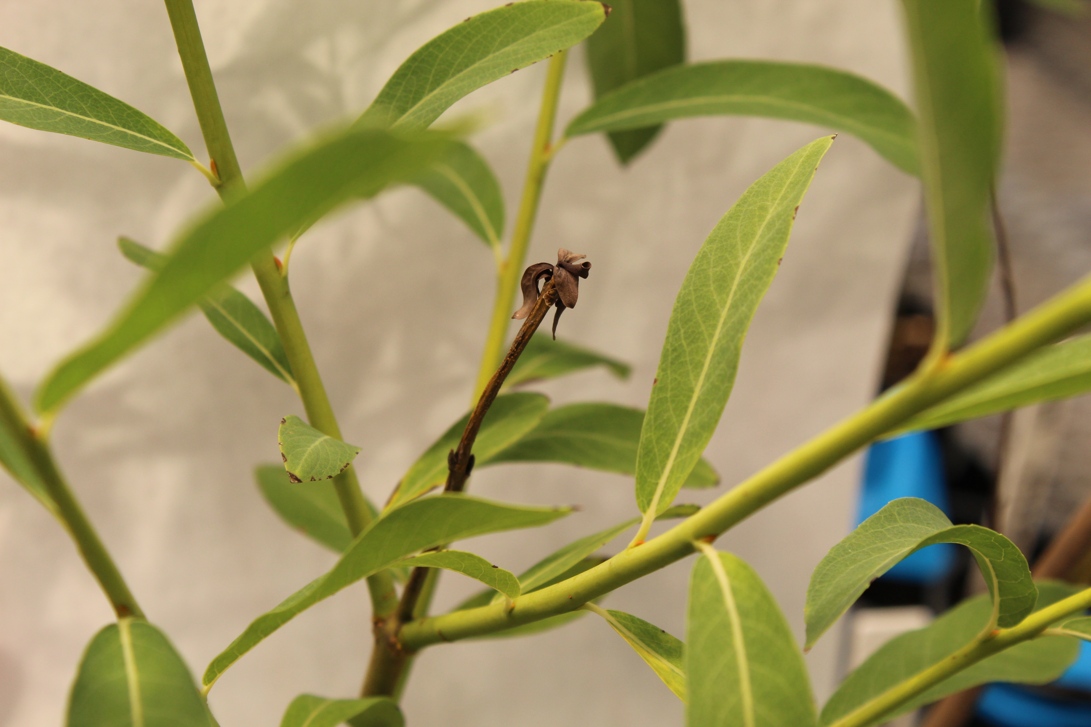
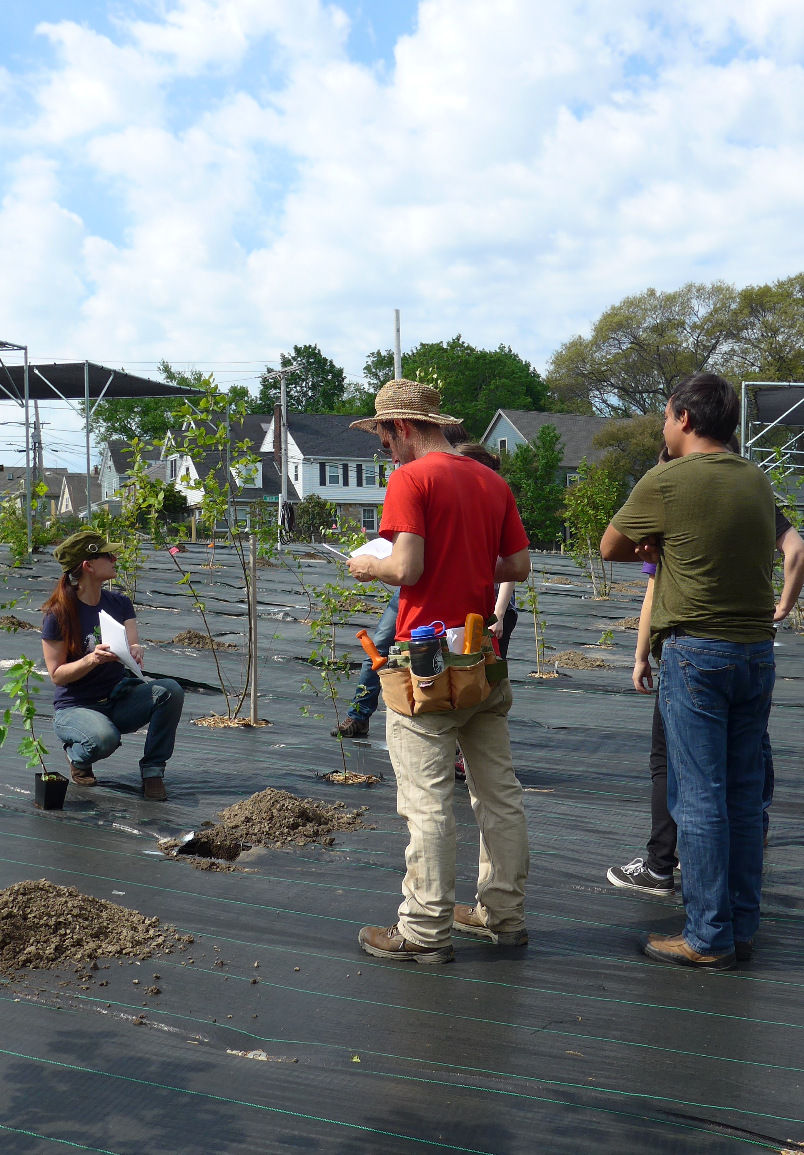
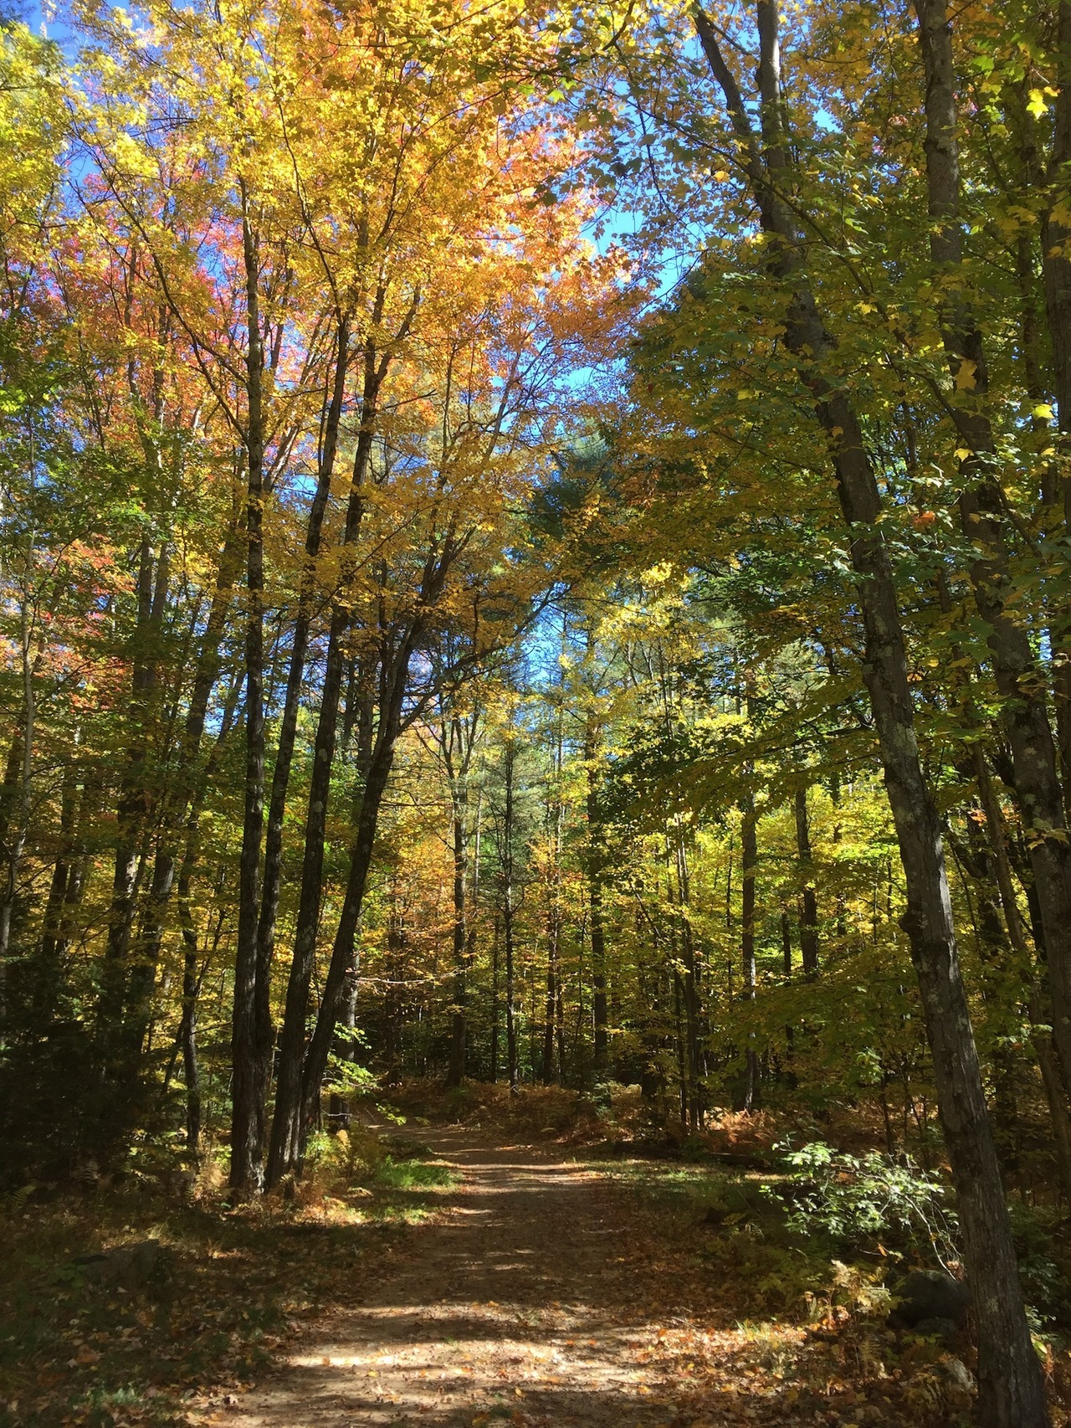
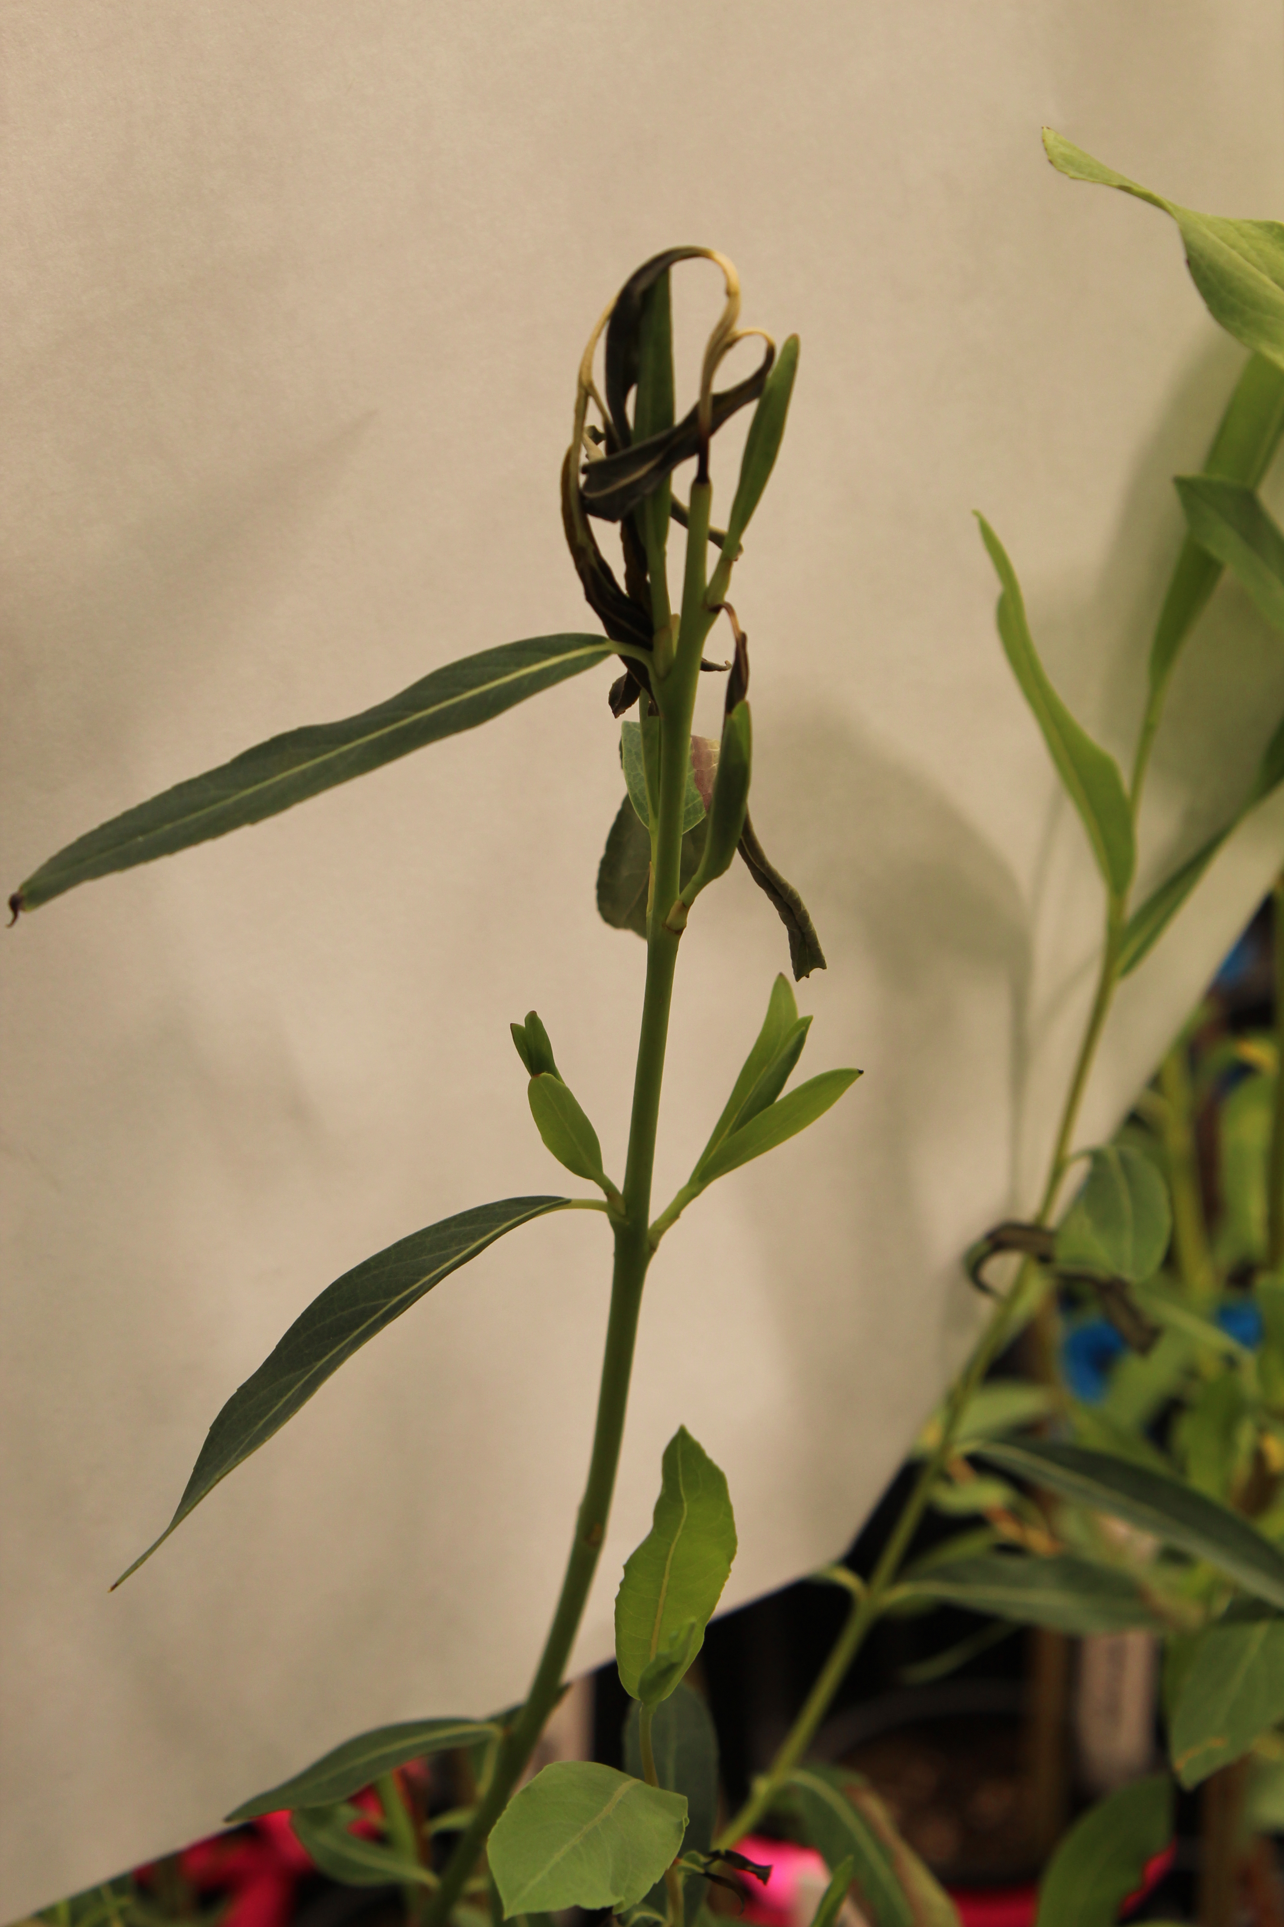
Drought Risk
Spring Freeze Risk
Growth Rate
Carbon Sinks

Slide 6
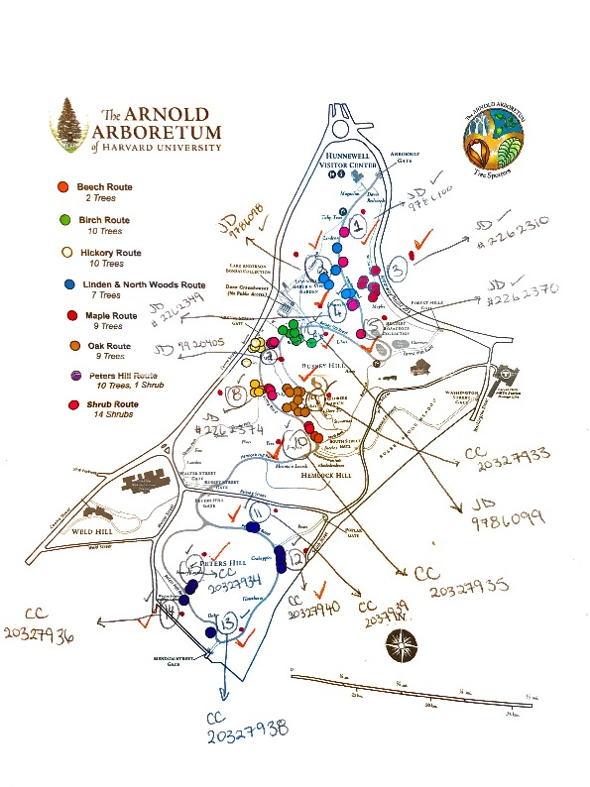
What’s the best way to calculate GDDs?
And how should we test this?

Slide 7
Can we use Weather Station climate data to calculate GDDs?

Slide 8
Understanding the growing season length
Provenance Latitude: where the seed came from

Slide 9
Understanding the growing season length (cont.)
Provenance Latitude: where the seed came from

Slide 10









THE TEMPORAL ECOLOGY LAB
Lizzie Wolkovich, PhD
Dan Buonaiuto
Ignacio Morales-Castilla, PhD
Aileen Ettinger, PhD
Deirdre Loughnan
Darwin Sodhi
ARNOLD ARBORETUM - TREE SPOTTERS
Suz Mrozak
Danny Schissler
Kate Stonefoot
Pam Thompson
Our Citizen Scientists!!
COMMITTEE MEMBERS
Paul Moorcroft, PhD
Neil Pederson, PhD
COLLABORATORS AND SPECIAL THANKS
Iñaki Garcia de Cortazar-Atauri, PhD
Ben Cook, PhD
Kea Woodruff
Faye Rosin
Alice Linder
Dan Flynn
Alissandra Ayala
John O’Keefe, PhD
Audrey Barker Plotkin
THE HOLBROOK LAB
Noel Michele Holbrook, PhD
Fulton Rockwell, PhD
Jess Gersony
Anju Manandhar
Meghan Blumstein
Morgan Furze, PhD
Zhe He

Slide 11
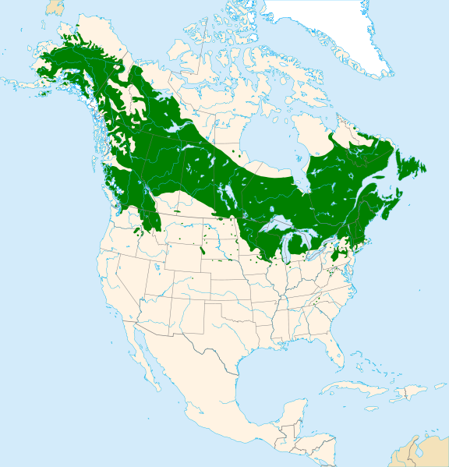
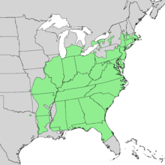
Work from Lizzie and UBC crew

Slide 12
Work from Lizzie and UBC folks

Slide 14
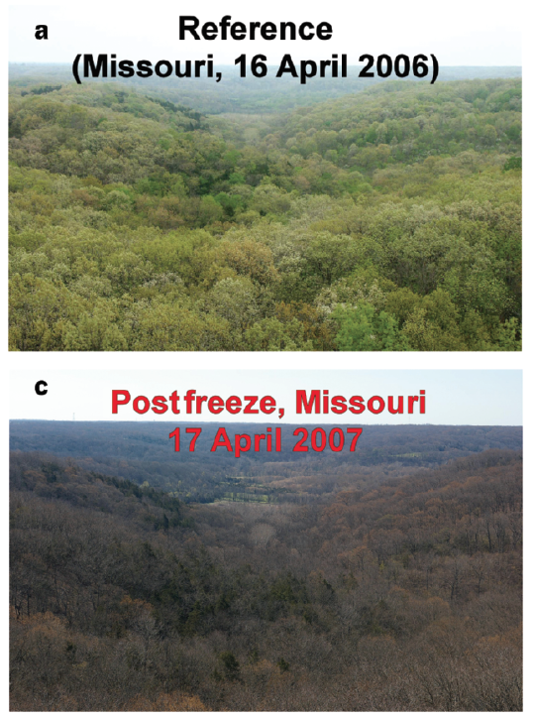
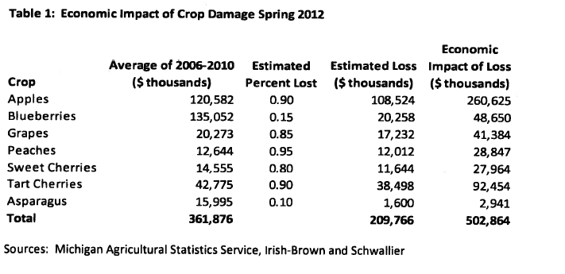
MASSIVE ECONOMIC AND ECOLOGICAL CONSEQUENCES
Gu et al, 2008
Knudson, 2012
Notes:
Talk here about the different phases and consequences of vegetative vs reproductive
16-38 days leafless and recovery time – scale that up and if freezing events are becoming more prevalent, could have major implications for carbon storage.

Slide 15
Frost tolerance
Phenology:
timing of life-history events
Over-Winter Chilling
Spring Warming
Daylength
Duration of Vegetative Risk

